Slide 1
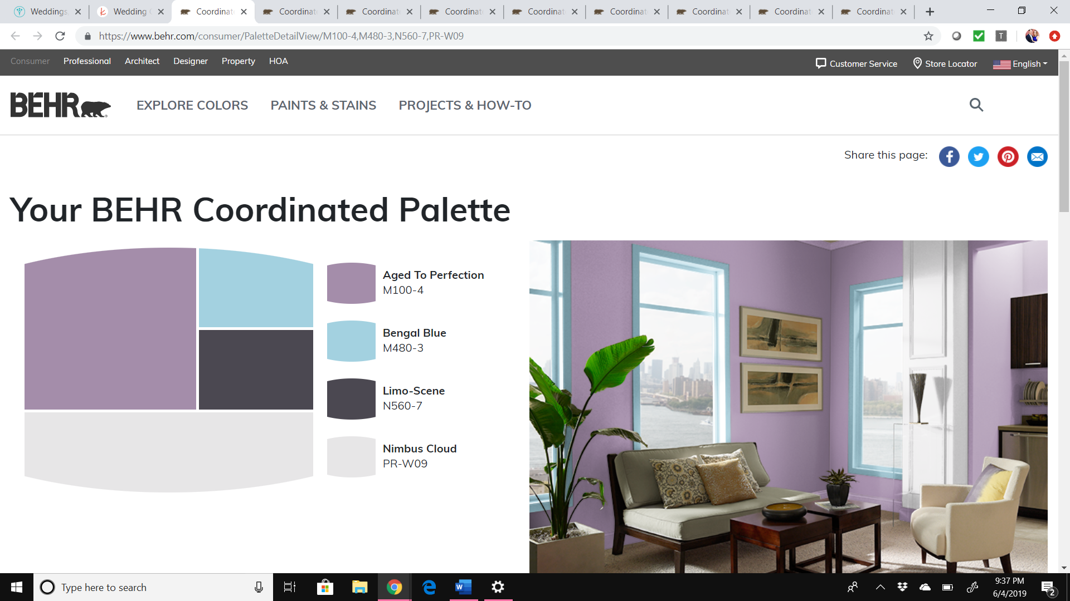
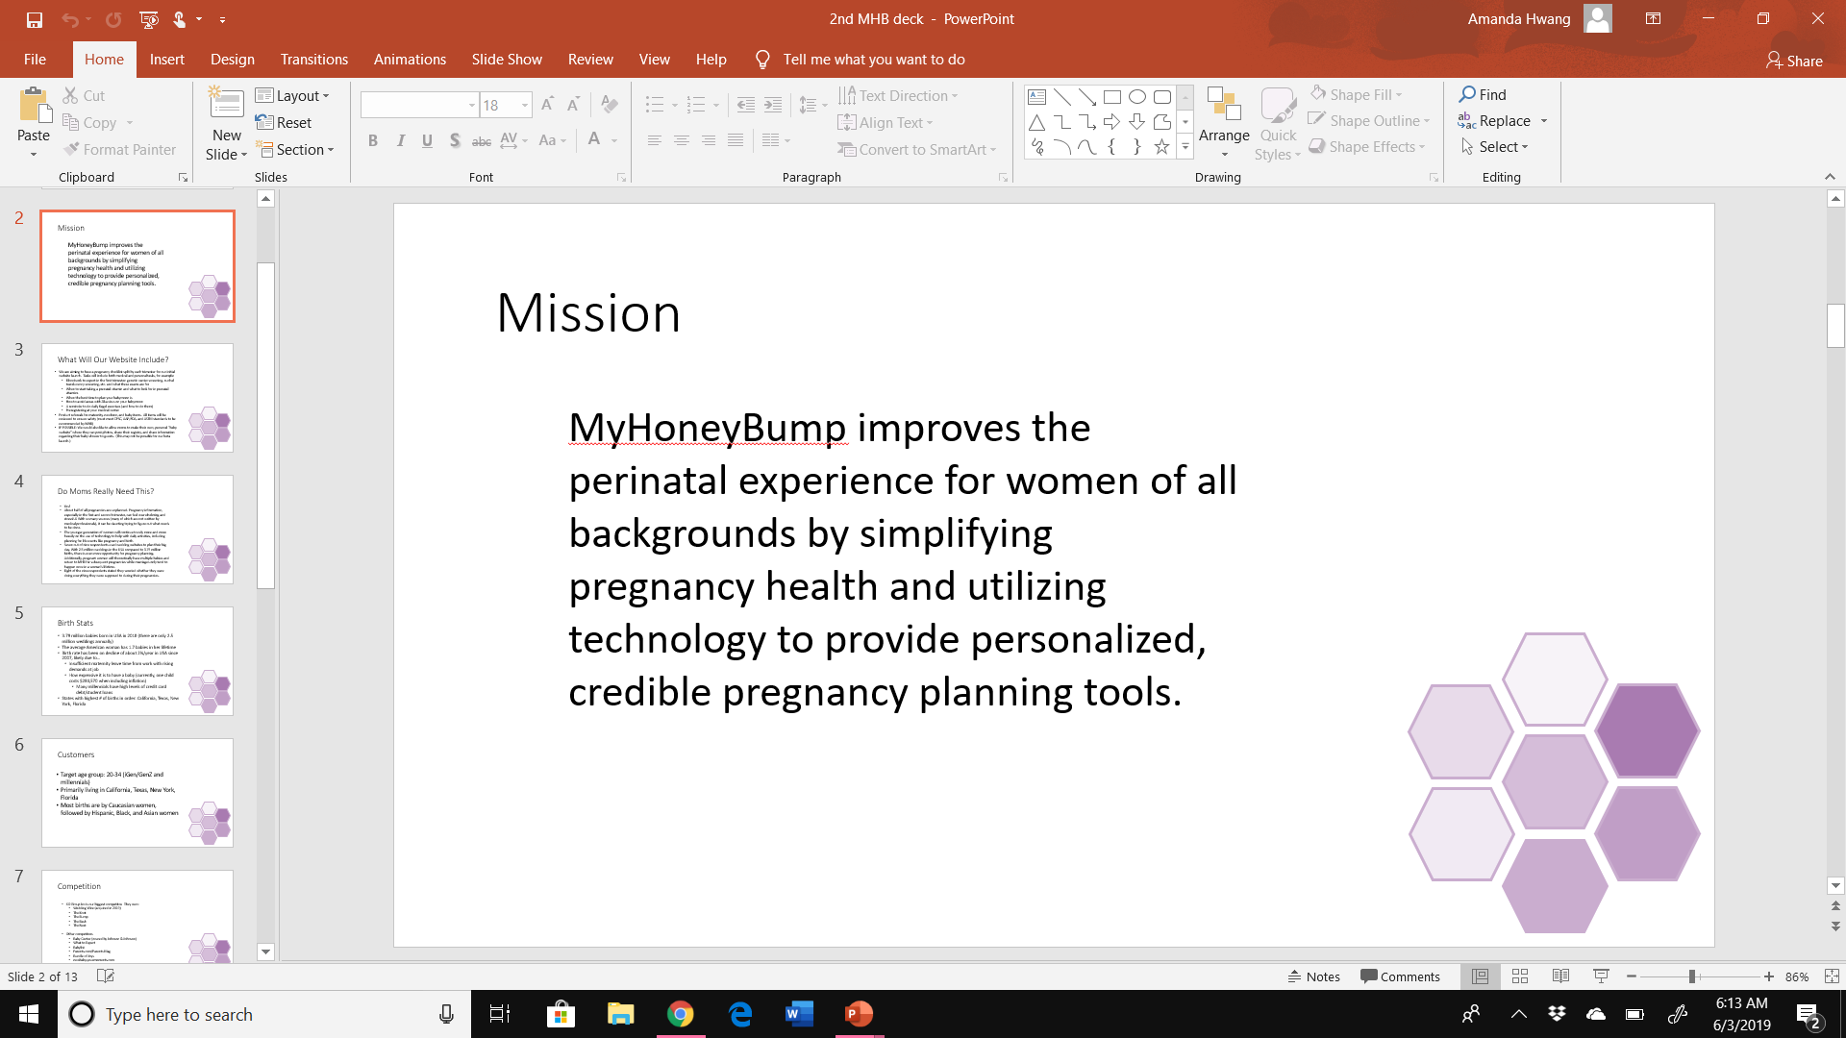
Welcome Page
myHoneyBump
myHoneyBump
myHoneyBump
myHoneyBump
Fonts online: https://fonts.google.com/
https://www.jordanprindledesigns.com/blog/7-font-combinations
Quicksand
Lato
Poiret one
Raleway
NUMBER 12 ON THIS PAGE FOR COLOR:
https://artisanthemes.io/best-google-fonts-color-combinations-feminine-website/

Slide 2
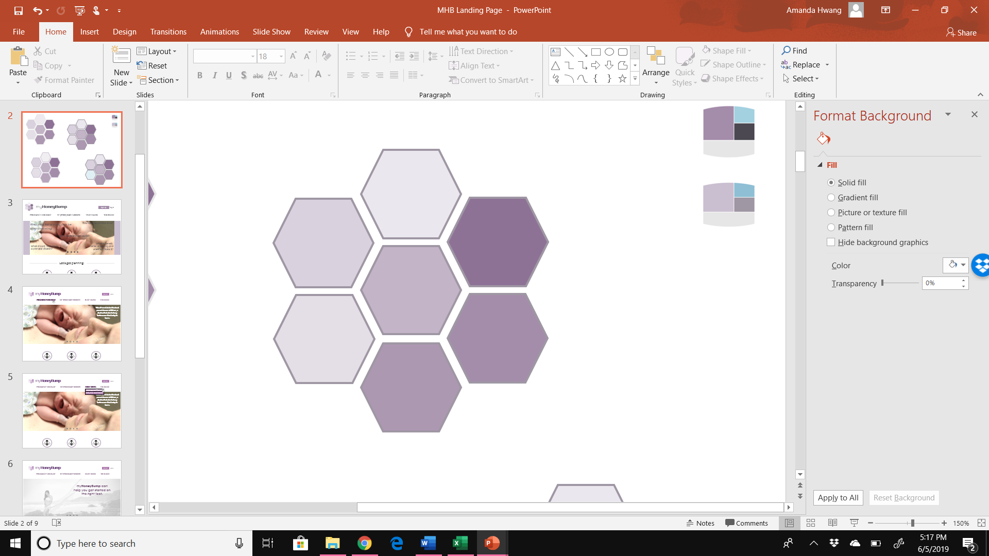
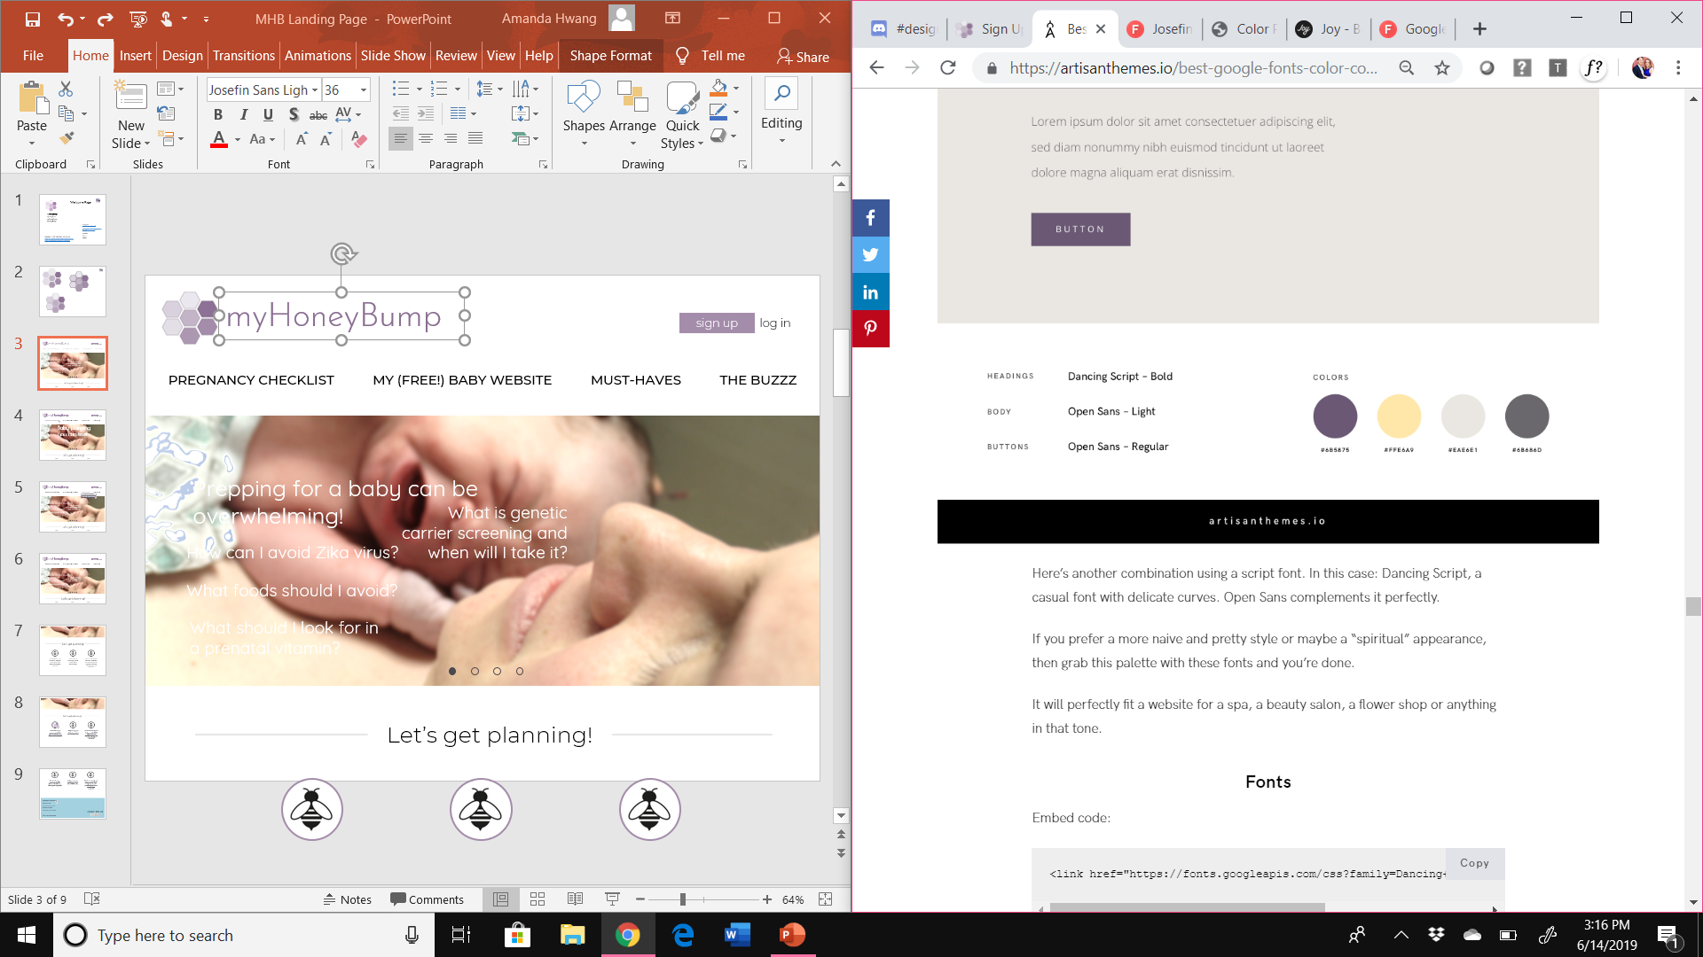

Slide 3
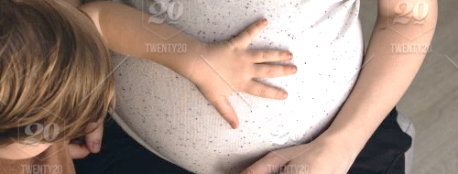
myHoneyBump
PREGNANCY CHECKLIST MY (FREE!) BABY WEBSITE MUST-HAVES THE BUZZZ
sign up
log in
Pregnancy planning made easy
create account
Why choose myHoneyBump?
Notes:
Website for the photo:
https://www.twenty20.com/photos/b2d248a2-baec-4268-beb6-1ebfc0314329
https://www.wedding-spot.com/

Slide 4
Why choose myHoneyBump?
Our goal is to simplify the who's, what's, when’s, why’s and how’s of your pregnancy. myHoneyBump breaks down the many mysteries and pregnancy questions so that you have more time to enjoy this once (or maybe more!) in a lifetime experience.
Sample picture of checklist
PREGNANCY CHECKLIST
Explore things like what tests to expect, when to announce your pregnancy, and when to start sleeping on your left side.
learn more
Sample picture of checklist
BABY SHOWER WEBSITE

Slide 5
Sample picture of checklist
PREGNANCY CHECKLIST
Explore things like what tests to expect, when to announce your pregnancy, and when to start sleeping on your left side.
learn more
BABY SHOWER WEBSITE
Sample picture of several baby website templates
Customize a FREE website for your baby shower! Send email invitations, collect RSVPs, and share your registry all in one place.
learn more
Sample picture of checklist
THE BUZZZ
learn more

Slide 6

Sample picture of “the buzz” page showing list of articles???
THE BUZZZ
Read pregnancy FAQs and get totally prepared before setting foot in the delivery room.
learn more
ABOUT myHoneyBump
CONTACT US
ADVERTISE WITH US
PRIVACY POLICY
TERMS & CONDITIONS
© 2019 myHoneyBump
CONNECT WITH US!

Slide 7
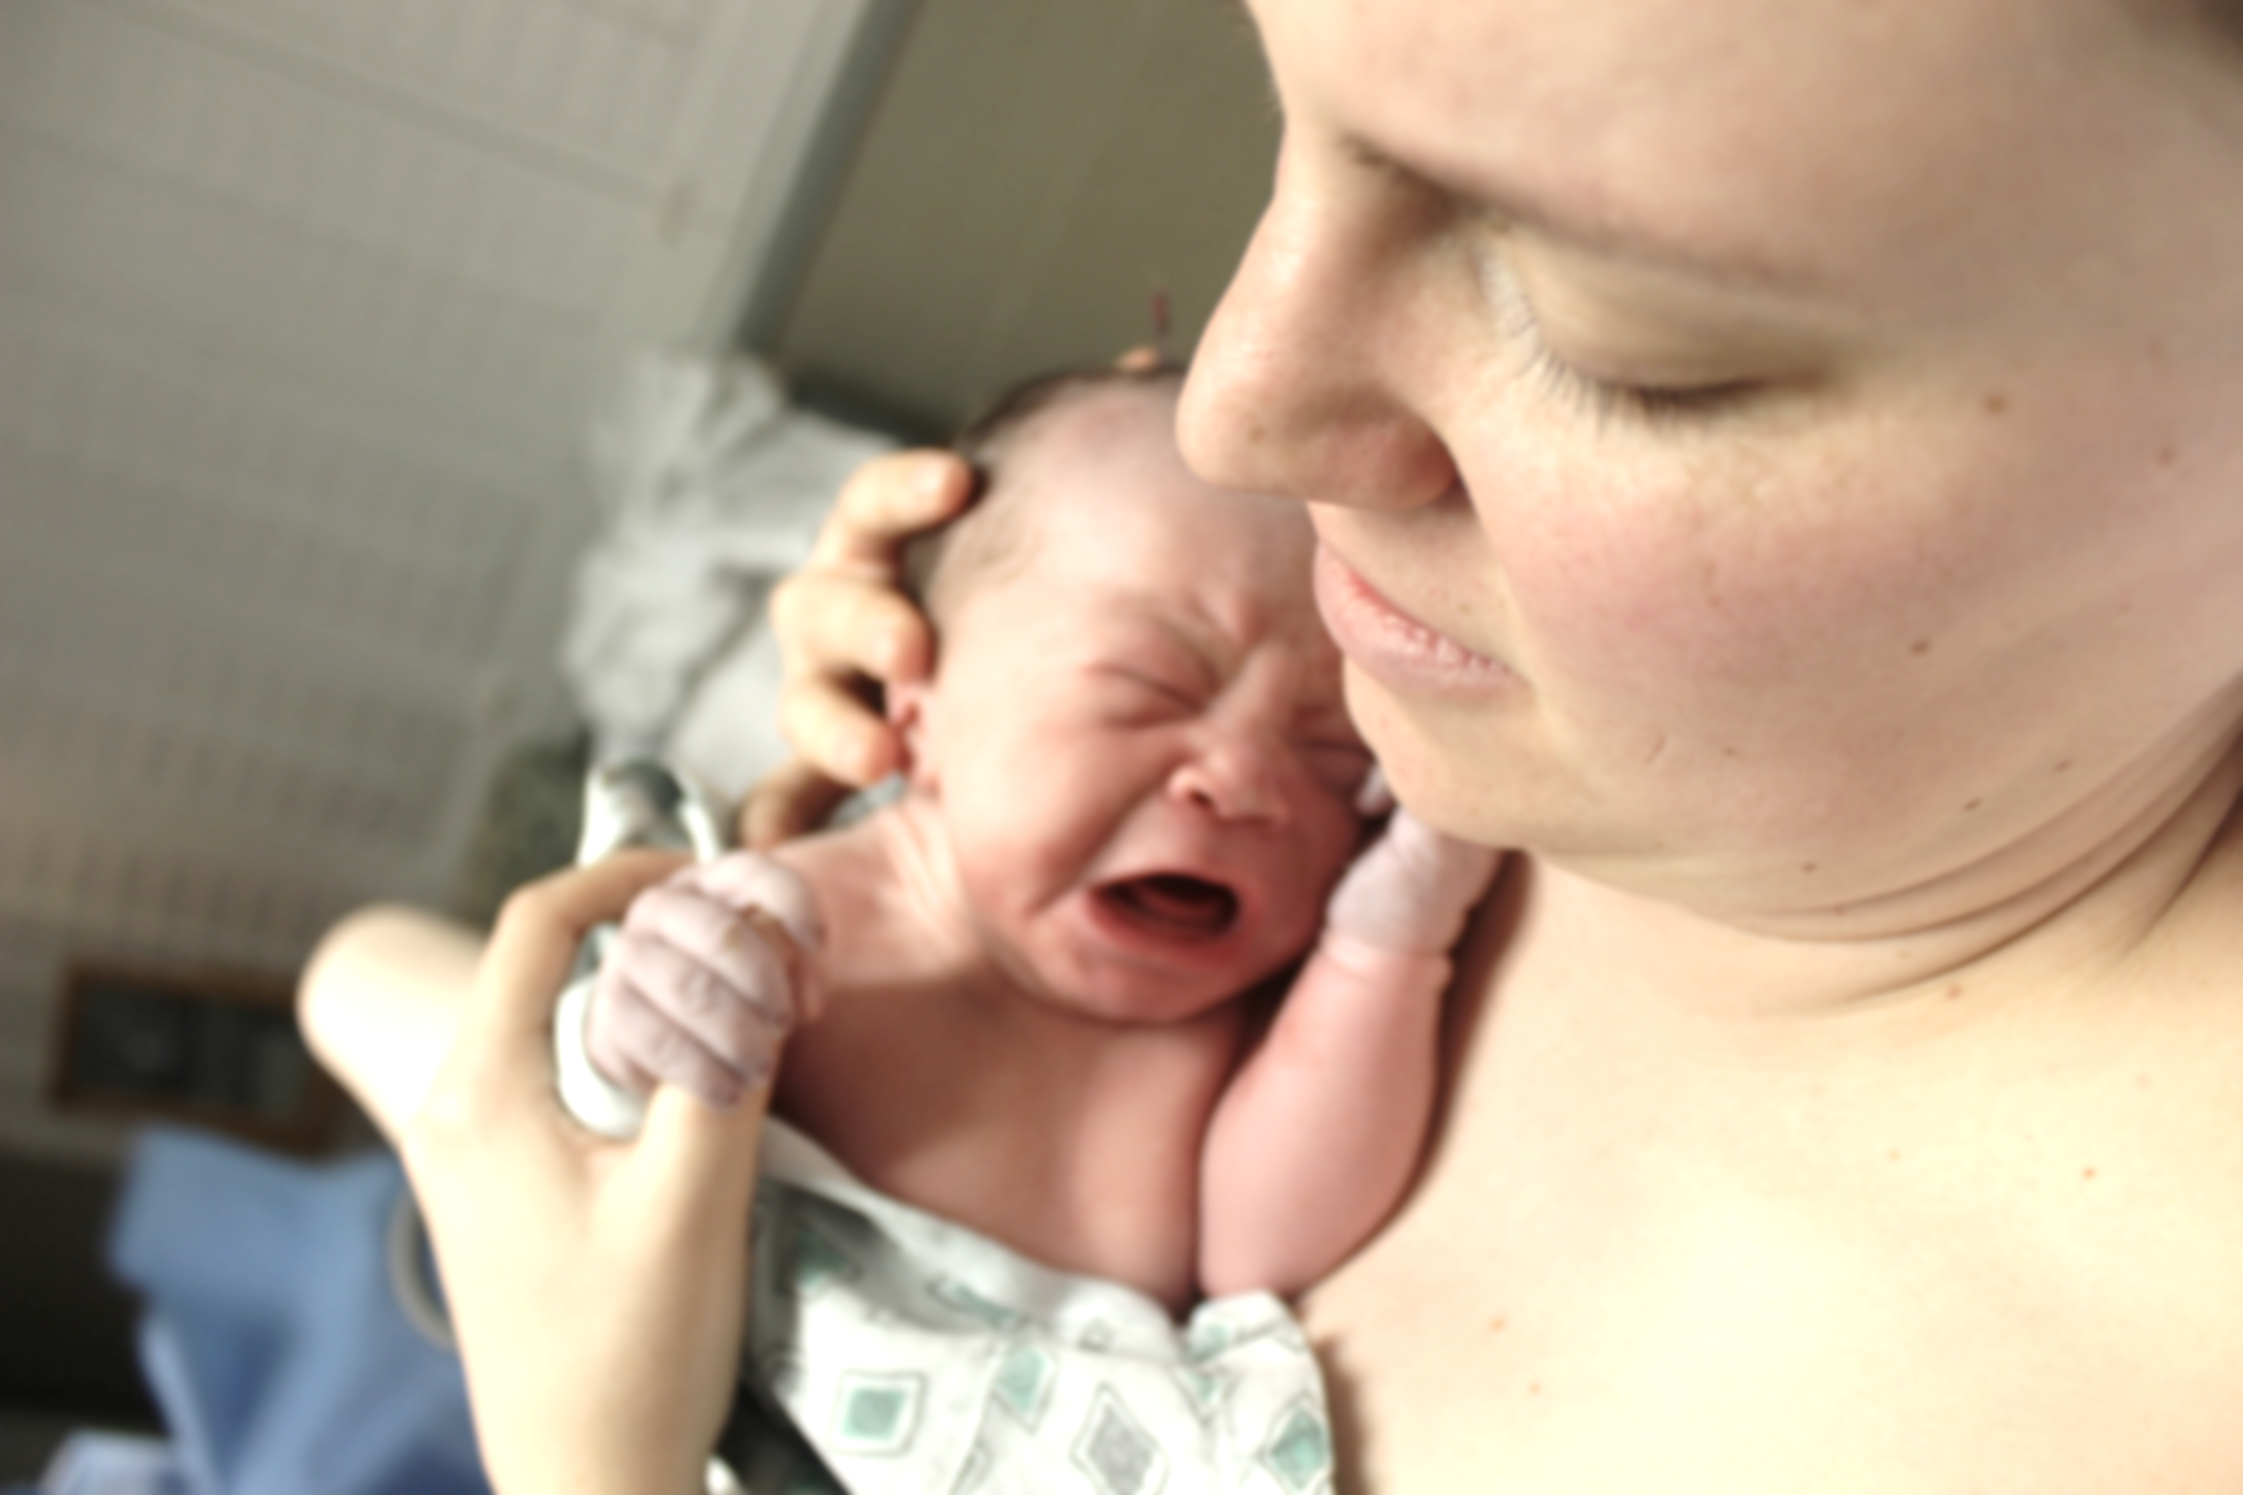

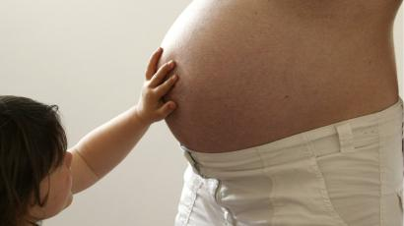


myHoneyBump
sign up
log in
PREGNANCY CHECKLIST MY (FREE!) BABY WEBSITE MUST-HAVES THE BUZZZ
Baby planning you can trust
Let’s get planning!
Notes:
When hovering over a word, turn the word the same color purple as rest of purple text on screen

Slide 8
myHoneyBump
sign up
log in
PREGNANCY CHECKLIST MY (FREE!) BABY WEBSITE MUST-HAVES THE BUZZZ
mommy must-haves
baby bee must-haves
Prepping for a baby can be overwhelming!
What is genetic carrier screening and when will I take it?
How can I avoid Zika virus?
What foods should I avoid?
What should I look for in a prenatal vitamin?
Let’s get planning!
Notes:
ALL DROP-DOWN BOXES TO HAVE WHITE BACKGROUND
WHEN HOVERING OVER A SPECIFIC BOX ON A DROP DOWN MENU, TURN THE BACKGROUND OF IT FROM WHITE TO LAVENDER AND CHANGE THE FONT FROM BLACK TO WHITE

Slide 9
myHoneyBump
sign up
log in
PREGNANCY CHECKLIST MY (FREE!) BABY WEBSITE MUST-HAVES THE BUZZZ
Prepping for a baby can be overwhelming!
What is genetic carrier screening and when will I take it?
How can I avoid Zika virus?
What foods should I avoid?
What should I look for in a prenatal vitamin?
Let’s get planning!
Notes:
SLIDESHOW: use approximately 4 photos that cycle every 4 seconds….something along the lines of…..
Slide 1: Prepping for a baby can be hard! [fade these questions onto screen one at a time]---what foods should I avoid? ---what kind of prenatal vitamin should I take? ---what is carrier screening and when will I take it? ---How can I avoid Zika virus?
Slide 2: myHoneyBump can help you get started on the right foot
Slide 3: Use your personalized pregnancy checklist with tasks divided by each trimester
Slide 4: Make your own FREE personalized baby website to share your maternity photos, baby registry, and have guests RSVP online for your baby shower

Slide 10
Let’s get planning!
Get started on your pregnancy checklist.
(You can start this even before you’re pregnant!)
Easily manage your baby shower guest list and RSVPs online.
Check out maternity and baby essentials. We’ll only recommend products that have met national safety standards!
Notes:
WE DO NOT OWN COPYRIGHT OF THIS BEE LOGO----WILL NEED TO CREATE OUR OWN

Slide 11

Let’s get planning!
Get started on your pregnancy checklist.
(You can start this even before you’re pregnant!)
Easily manage your baby shower guest list and RSVPs online.
Check out maternity and baby essentials. We’ll only recommend products that have met national safety standards!
Notes:
When the mouse hovers over one of the bees before clicking it, change the image to our logo

Slide 12

Get started on your pregnancy checklist.
(You can start this even before you’re pregnant!)
Easily manage your baby shower guest list and RSVPs online.
Check out maternity and baby essentials. We’ll only recommend products that have met national safety standards!
ABOUT myHoneyBump
CONTACT US
ADVERTISE WITH US
PRIVACY POLICY
TERMS & CONDITIONS
© 2019 myHoneyBump
CONNECT WITH US!
Notes:
***NEED TO FIND free social media icons that are clickable
NEED TO FIGURE OUT COPYWRIGHT LAWS---HOW TO GET IT AND DO WE NEED “C2019” AT THE BOTTOM OF EVERY PAGE?
--bottom of page that with blue background will contain text that is written in dark grey at baseline. When hovered over, the font will turn to black prior to clicking

